Slide 1
Problem Statement 3 Architecture
A multi-modal lightweight architecture for CheXpert (X-ray) + 2D CT images to classify lung diseases (including cancer) with explainability and graph-based feature optimization.

Slide 2
Proposed Architecture – Phase 1 (Easier One)
A. Dual 2D Encoders (Efficient & Lightweight)
  CheXpert Encoder: EfficientNet-B0 or MobileNet-V3 (2D CNN).
  2D CT Encoder: Same backbone for alignment & efficiency.
  Outputs: Low-dimensional feature vectors (e.g., 256–512D).
B. Lightweight Multi-Modal Fusion
  Fusion Mechanism:
    Simple feature concatenation of CT and X-ray embeddings.
    Followed by Squeeze-and-Excitation (SE) attention block (lightweight attention) to recalibrate important modality features.
C. Graph-based Feature Optimization (Simplified GNN)
  Nodes:
    Patient nodes: Each patient’s fused embedding.
    Disease-class nodes: One per disease label (from CheXpert + cancer).
  Edges:
    Patient ↔ Disease: Connect if patient has that disease label.
    Disease ↔ Disease: Weighted by co-occurrence frequency.
  Graph Network:
    Single-layer Graph Attention Network (GAT) (lightweight compared to HG-CapsGNN).
    Optimizes patient features using disease relationships and vice versa.
D. Classifier + Explainability
  Output layer: Multi-label classification (CheXpert + cancer).
  Explainability:
    GradCAM / Score-CAM on X-ray & CT encoders for visual explanations.
    Rule-based textual explanation:
      Extract top contributing regions + disease graph activations.
      Convert into human-readable explanation (no heavy LLM needed initially).

Slide 3
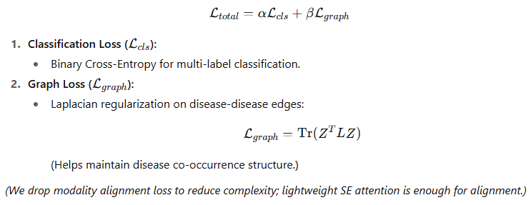
Proposed Loss Function to be used in the Model

Slide 4
Pipeline Flow (Simplified)
Input: CheXpert X-rays + 2D CT slices.
Dual Encoders → Feature extraction.
SE-based fusion → Unified patient representation.
Graph construction (Patient & Disease nodes) → Single-layer GAT.
Classifier → Predictions + Explainability.

Slide 5
Enhancement made to the Proposed Architecture (Phase 2)
A. Adaptive Multi-Modal Knowledge Distillation
  Problem Addressed:
    In real-world settings, a patient may have only X-ray or CT available. Models trained on both modalities fail when one is missing.
  Proposed Technique:
    Teacher Model:
      The full multi-modal (X-ray + CT) graph-based network trained on all available data.
    Student Models:
      Two lightweight single-modality models (one for X-ray, one for CT).
    Knowledge Distillation Process:
      The teacher generates soft labels (class probabilities & intermediate feature embeddings).
      Student networks learn to replicate teacher predictions even when only a single modality is provided.

Slide 6
B. Graph Memory Bank for Rare Disease & Cancer Cases
  Problem Addressed:
    CheXpert is highly imbalanced (e.g., cancer cases are rare). Graph-based models can overfit common diseases, underperforming on rare classes.
  Proposed Technique:
    During training, we build a memory bank (a key-value store):
      Key: Feature embedding of rare-class patient nodes.
      Value: Corresponding disease label(s).
  At inference:
    Query the memory bank with the current patient embedding.
    Retrieve the K most similar rare-class embeddings.
    Adjust predictions with a weighted similarity score.
  Implementation Details:
    Similarity metric: Cosine similarity or learned metric.
    Memory update: Bank is updated online during training to store diverse rare-class samples.

Slide 7
D. Hierarchical Explainability Framework
Problem Addressed:
Most explainability methods only show saliency maps (GradCAM), which are insufficient for clinical trust.
Proposed 3-Tier Framework:
      Visual Explanations:
        Apply GradCAM/Score-CAM on X-ray and CT encoder outputs.
        Show which lung regions influenced the prediction.
      Graph-Level Explanations:
        Extract the most influential disease nodes and edges in the patient–disease graph.
        Example: "Cancer node and its connection to Effusion node had the highest message passing score."
      Natural Language Explanations (LLM-powered):
        Feed top visual regions and graph nodes into a fine-tuned BioGPT / MedAlpaca LLM.
        Generate human-readable rationale:
"The model predicts cancer because a suspicious upper lobe nodule was detected on CT and this region co-occurs with effusion, which increases cancer probability."

Slide 8
Advanced Workflow
Dual Encoder Backbone (X-ray + CT)
Graph Module (GAT) + Memory Bank
Knowledge Distillation (Adaptive)
Hierarchical Explainability

